Slide 1
Medical Insurance price prediction
By;
Sanjai,
Anusha,

Slide 2
Introduction
Data sets
Data Preparation
Using Algorithm
Testing and training the data
Conclusion

Slide 3
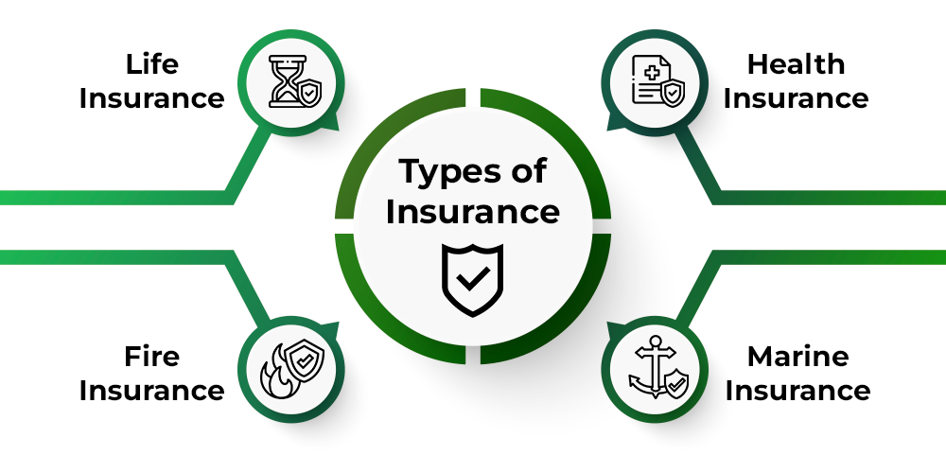

Slide 4
Abstract & Introduction
"Insurance aims to mitigate financial losses due to various risks, and its cost is influenced by multiple factors. Machine Learning (ML) can enhance the effectiveness of insurance in various domains. While ML is a well-established research field in computational mathematics, it has limitations in predicting medical insurance costs. This study employs ML algorithms such as Linear Regression as a framework, using a medical insurance cost dataset from KAGGLE. The goal is to improve the accuracy of healthcare insurance cost prediction."
"Introduction: In a world fraught with uncertainties and risks, insurance offers a vital shield against financial losses stemming from various threats. The precision of insurance cost estimation is crucial for individuals and organizations. Machine Learning (ML) provides a means to enhance this precision, automating cost calculations and improving accuracy. Our objective is to predict insurance costs by leveraging regression models.

Slide 5
HEALTHCARE ANALYTISCS MARKET
Real time analytics is carried out on the spot and helps in quick decision making, for instance, clinical decision support software with active knowledge system use two or more items of patient data to generate case specific advice.
Batch Analytics retrospectively evaluates past data such as patient records and claims data from an insured population, which helps in predictive modeling cost control measures.

Slide 6
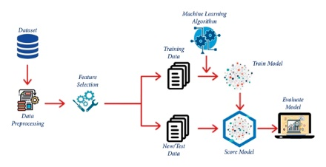

Slide 7
DATASET
We had used a dataset from Kaggle Site for creating our prediction model. This data set includes 7 attributes and the data set has splitted into two-parts : training data and testing data. For training the model, 80% of total data is used and the rest for testing. In this project we use linear regression algorithms.

Slide 8
Data Preparation
The dataset consists of 7 variables, each contributing to the estimation of insurance costs, our dependent variable. Categorical variables have been transformed into binary values, simplifying their representation for ML algorithms. This processed data is now ready for use in our regression models."

Slide 9
Algorithm
Multiple Linear Regression: Multiple regression analyzes the relationship between one variable and multiple independent variables, represented by the formula:
Y = M0 + M1X1 + M2X2 + ... + MnXn
M0= Y Intercept
M1,M2,….etc = Slope coefficient
Y= Dependent variable
X1,X2…. Etc =Independent variable

Slide 10
Linear Regression: Linear regression is a statistical method used for modeling the relationship between a dependent variable and one or more independent variables by fitting a linear equation to the observed data. It is a fundamental technique in the field of statistics and data analysis, particularly in the domain of predictive modeling and understanding the relationships between variables.
Implementation: The study predicts insurance costs based on variables like age, sex, BMI, region, Children, smoker, charges. The dataset is split into training and test data, with models trained on the former and evaluated on the latter.
Fitting the Model
Linear Regression:
Score Train – 75.6
Score Test -72.4

Slide 11
Conclusion
The study employs machine learning regression models to predict health insurance costs using a medical cost dataset from Kaggle.com. Predicting insurance prices based on specific factors aids insurers in attracting customers and streamlining policy formulation. Machine learning significantly reduces the time and effort required for cost calculations, ultimately improving business profitability. ML models excel at handling large datasets.

